Slide 1

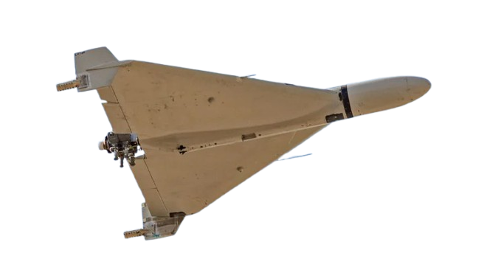
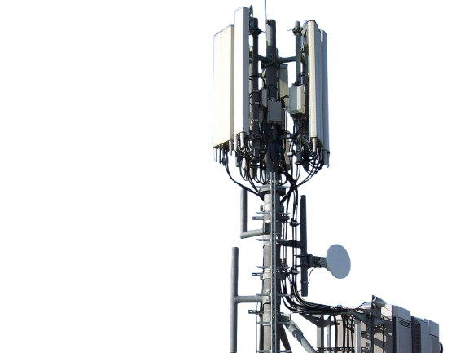
A Physical Layer
Formalization
Hierarchical Timed-Automata Evaluation Model for Resource Orchestration and Resilience in SDN-Enabled Computation-Centric 6G ISAC Networks
αPHY : Xmeas × Xcfg → Xdisc
Vadim Tinishov
PHY formalization | 1/9
Notes:
This talk presents the physical layer formalization for an SDN-enabled 6G ISAC network. The focus is resource orchestration and resilience, not a full radio-physics simulator. Timed automata do not calculate SINR, detection probability or CRB directly. These values are estimated outside the automata. Then they are mapped to finite classes. These classes become the inputs for contract timed automata, which can be checked by UPPAAL-style verification.

Slide 2

to define a verifiable PHY abstraction that reports communication and sensing degradation to MAC and SDN control within bounded deadlines
Outline
• role of PHY in the hierarchical model
• continuous-to-discrete abstraction
• contract timed automata for channel, signal, beam and sensing
• SensCAP, freshness and penalty score
• UPPAAL-ready observers and verification targets
PHY formalization | 2/9
Notes:
The objective is practical: to define a physical layer abstraction that can be used inside a model checker. The layer must report communication and sensing degradation to MAC and SDN within bounded time. The talk follows five points. First, I show the position of PHY in the hierarchy. Then I explain the abstraction function, the automata, the sensing capability metrics, and finally the verification logic with observer automata.

Slide 3
Methods are
The PHY layer is formalized as a controlled abstraction, not as an I/Q waveform simulator.
1
Estimate PHY values outside automata
SINR, BLER, Pd, Rfa, CRB, beam error, AoS
2
Discretize to finite classes
ChannelClass, SignalClass, BeamClass, SensingState
3
Verify bounded reactions
reports, recovery commands, observers, no-deadlock checks
Ai = (Li, l0i, Ci, Vi, Ei, Invi, Ini, Outi, Assi, Gari)
Each component is a contract timed automaton with explicit clocks, guards, resets, invariants and input/output channels.
PHY formalization | 3/9
Notes:
The method has three steps. First, the estimator layer computes physical values, such as SINR, BLER, probability of detection, false alarm rate, beam error, and age of sensing. Second, the abstraction function maps these values to finite classes. Third, these classes become guards, updates, and report events in timed automata. This design keeps the model finite, avoids an unrealistic state space, and still preserves the information needed by upper control layers.

Slide 4
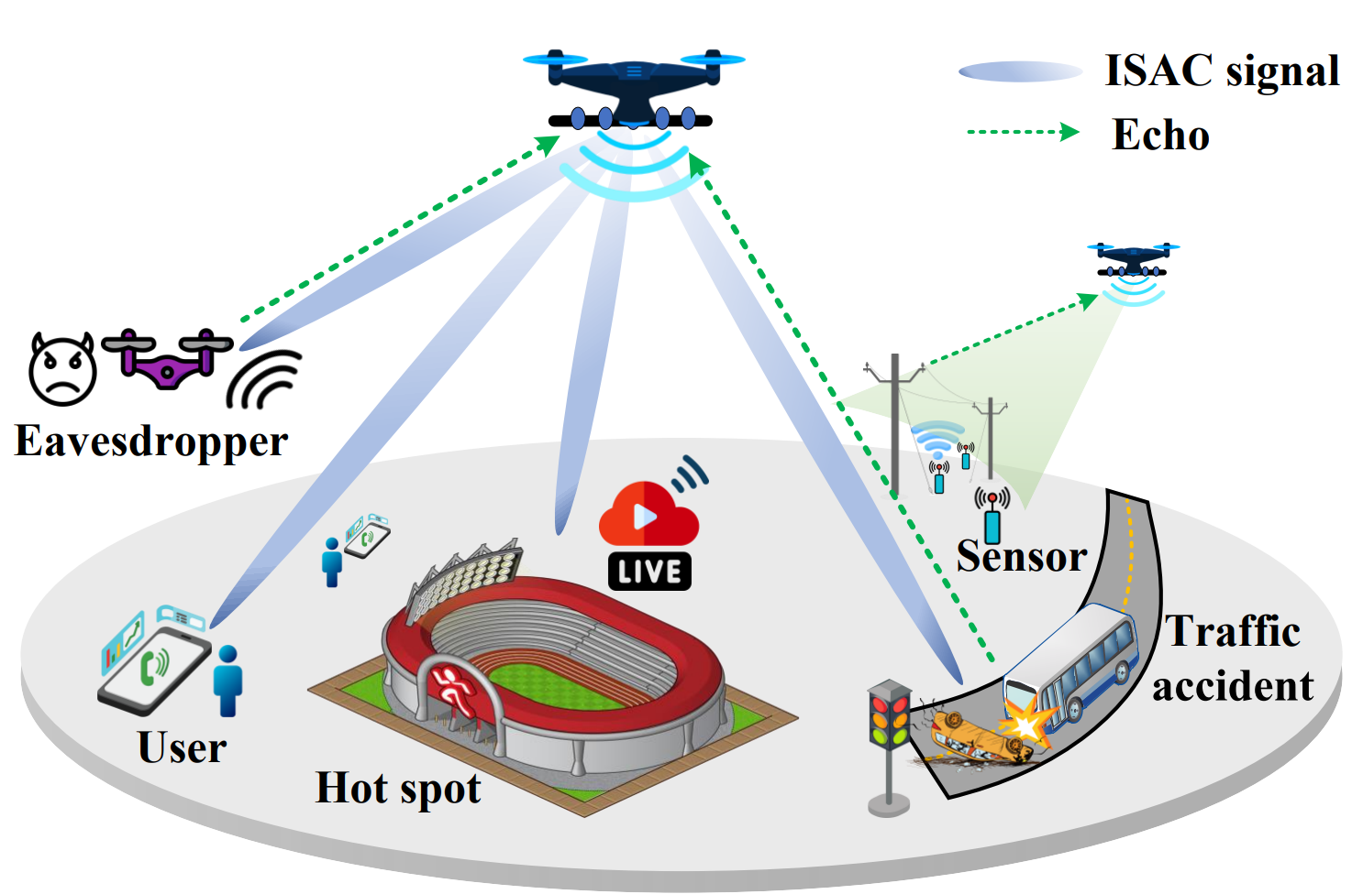
PHY position in the hierarchy
The layer publishes classified reports upward and receives bounded control commands downward.
Application / Service
SLA: delay, reliability, Pd, false alarm, freshness
SDN control plane
global policy, recovery and orchestration
MAC / resource scheduling
pilots, PRS, power, MCS and beam commands
PHY abstraction layer
finite KPI classes and degradation reports
Fig. 1. ISAC scenario used as context: communication and sensing share the same infrastructure.
Environment / estimators
radio measurements and analytical estimates
ASYS = ACH ∥ ASIG ∥ ABM ∥ ASQ ∥ APH ∥ AENV
PHY formalization | 4/9
Notes:
The physical layer is the lower measured part of the hierarchy. The service layer defines SLA requirements. SDN selects global policies and recovery actions. MAC implements radio-resource scheduling, such as pilot density, PRS resources, power, MCS, and beam commands. PHY receives these commands, observes the environment through estimators, classifies the current state, and reports degradation. This makes PHY a measurement and reporting layer for orchestration, not the global decision maker.

Slide 5
Continuous PHY values are converted into finite classes
Only classes enter the timed automata guards.
αPHY : Xmeas × Xcfg → Xdisc
SINRClass = OUTAGE if SINRc < SINRout; LOW if SINRout ≤ SINRc < SINRmin; OK/HIGH otherwise
Component
Main classes
Meaning for guards
Channel
NOMINAL, INTERFERENCE, MOBILITY, MULTIPATH, BLOCKAGE, OUTAGE
communication condition
Signal
PILOT_BASED, PAYLOAD_ASSISTED, RECONFIGURING, LIMITED
available signal mode
Beam
SEARCH, TRACK, LOCKED, MISALIGNED, RECOVERING, FAILED
spatial alignment state
Sensing
QoSOk, ProbabilityLimited, FalseAlarmLimited, FreshnessLimited, Failure
sensing quality state
Conservative rule: boundary and uncertain measurements are mapped to the worse neighboring class.
PHY formalization | 5/9
Notes:
The key bridge is alpha PHY. It maps measured values and configuration values to a discrete set. Continuous values are not used directly in guards. For example, SINR is converted into OUTAGE, LOW, OK, or HIGH. Similar classes are used for channel, signal, beam and sensing quality. The abstraction is conservative. If a value is close to a boundary or has uncertainty, it is mapped to the worse neighboring class. This reduces false safety in verification.

Slide 6
Contract automata of the PHY layer
The aggregate automaton reads child reports and publishes one PHY state.
ACH
channel
ASIG
signal
ABM
beam
ASQ
sensing quality
APH
PHY aggregate
broadcast reports: channel_report!, signal_report!, beam_report!, sensing_report!
comm_ok := ChannelClass in {NOMINAL, INTERFERENCE, MOBILITY, MULTIPATH} AND SignalClass != LIMITED AND BeamClass notin {FAILED, MISALIGNED}
sensing_qos_ok ≡ SensingState = SensingQoSOk
PHY formalization | 6/9
Notes:
The PHY layer is decomposed into four child automata and one aggregate automaton. A CH tracks the channel class. A SIG tracks the signal configuration, for example pilot-based or payload-assisted sensing. A BM tracks beam search, tracking, misalignment and recovery. A SQ evaluates sensing quality. Their reports are broadcast, because more than one consumer may need the same event. A PH combines the reports and publishes one global PHY state.

Slide 7
Results
Radio estimators are separated from the timed-automata core.
1
Communication and sensing degradation are represented by explicit PHY states.
2
Output state set
Reports and recovery reactions can be checked with bounded observers.
3
PHYNormal
PHYCommunicationDegraded
PHYSensingDegraded
PHYJointDegraded
PHYRecovery
PHYFailure
PHY formalization | 7/9
Notes:
The result is a working formal PHY abstraction. First, radio estimators are separated from the automata core, so the model does not pretend to calculate physics internally. Second, communication degradation and sensing degradation are explicit states. This is important because a communication problem and a sensing problem are not always the same. Third, reports, recovery actions and deadline requirements can be checked with observer automata and clocks.

Slide 8
Conclusion & Future Implementation
The formalization is ready to be connected to MAC/SDN policy automata.
1
Conclusion
PHY is modeled as a finite, conservative contract layer. It does not prove radio probability values itself; it proves timely reaction to classified PHY events.
2
SensCAP and score are used as estimator / SDN inputs
P_d(R_fa)=N_det/N, C_s(Q_s,T_0)=N*(Q_s,T_0)/A, AoS_CTRL(t)=t−t_ctrl_last
Π_PHY = Σ w_i Π_i, w_i ≥ 0, Σ w_i = 1
3
Future implementation
• calibrate class thresholds with simulation or field traces
• connect PHY reports to MAC scheduling and SDN/RIC recovery policies
• check bounded response observers in UPPAAL XML/XTA
Sources: Li et al. 2026; Liu et al. 2024; Liu et al. 2026; Huang et al. 2026; Alur & Dill 1994; UPPAAL docs.
PHY formalization | 8/9
Notes:
To conclude, the PHY layer is a finite and conservative contract layer. It does not claim that timed automata calculate detection probability, false alarm rate, or CRB. SensCAP-type metrics are used at the estimator or SDN-score side, then converted to classes such as ProbabilityLimited, FreshnessLimited, or CapacityLimited. The next implementation step is to calibrate thresholds with simulation or field traces, connect PHY reports to MAC and SDN policies, and check bounded response observers in UPPAAL XML or XTA.

Slide 9
THANK YOU
FOR YOUR TIME!
Questions?
PHY formalization | 9/9
Notes:
This completes the presentation. I am ready to discuss abstraction thresholds, automata interfaces, and the UPPAAL implementation details.

